Slide 1
TensileConv update
Wong,Fei
Feb. 2019

Slide 2
outline
Pre-work
Status
Performance
Auto Tuning
Library and API
Future Work

Slide 3

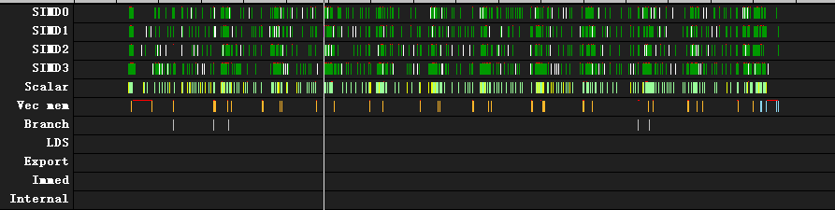
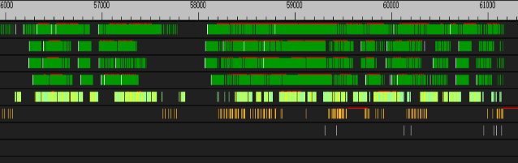
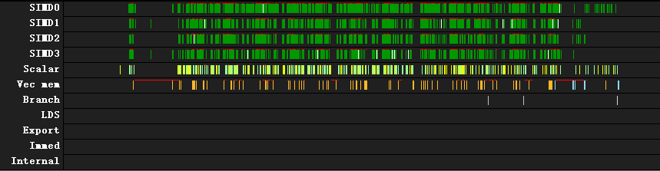
Pre-work
  Tensile Conv use a Auto-Tuning method which is to auto generate convolution 1x1 forward kernel code and achieve peak performance
    Kernel generation: gfx900
    Auto tuning: brute
    Prefetch method
Go through all problem parameters
Generate one problem handle
  Thread trace without prefetch : 169528 cycle
Go through all solutions
SQC miss: 6488 cycle
Generate one solution handle
169528 cycle
Go through all kernel config
  Thread trace with prefetch : 102296 cycle
    Weight hit in SQC for each Conv loop
Generate kernel code
SQC hit : 3144 cycle
Launch kernel
102296 cycle
Gather performance data

Slide 4
status
  Tensile Conv use a Auto-Tuning method which is to auto generate convolution 1x1 forward kernel code and achieve peak performance
    Support all WHCKN size combination
    Support fusion opts: convolution + relu/Prelu + bias
    Support brute-force search and genetic search
    Support different hardware ISA: gfx900 , gfx803
    Supply C++ library and interface
    Support offline and online tuning
    Supporting Baidu Anakin project

Slide 5
Performance – gfx800
  Conclusion: TensileConv could achieve better performance on Fiji than P4
    Conv 1x1 performance on AMD Fiji vs NVIDIA P4
    20 different size combination for Conv 1x1
    Left figure shows P4 minus Fiji runtime, the higher the better
    Right table is the test size and specific value
      P4 data comes from Anakin project team
ID | W | H | C | K | P4 | Tensile | Diff | Efficiency
1 | 7 | 7 | 512 | 2048 | 83.6218 | 57.2 | 26.4218 | 20.90%
2 | 7 | 7 | 1024 | 512 | 37.025 | 29.7 | 7.325 | 20.10%
3 | 7 | 7 | 1024 | 1024 | 86.1411 | 61.4 | 24.7411 | 19.50%
4 | 7 | 7 | 2048 | 512 | 69.4365 | 62.6 | 6.8365 | 19.10%
5 | 7 | 7 | 2048 | 1024 | 137.124 | 114.8 | 22.324 | 20.80%
6 | 7 | 7 | 2048 | 2048 | 245.688 | 218.5 | 27.188 | 21.90%
7 | 14 | 14 | 256 | 1024 | 59.4628 | 38.8 | 20.6628 | 30.80%
8 | 14 | 14 | 512 | 256 | 23.4109 | 22.4 | 1.0109 | 26.70%
9 | 14 | 14 | 512 | 512 | 41.5939 | 38.6 | 2.9939 | 31.00%
10 | 14 | 14 | 512 | 1024 | 78.3258 | 74.2 | 4.1258 | 32.20%
11 | 14 | 14 | 1024 | 256 | 47.6812 | 39.3 | 8.3812 | 30.40%
12 | 14 | 14 | 1024 | 512 | 61.8133 | 80 | -18.1867 | 29.90%
13 | 14 | 14 | 1024 | 1024 | 141.149 | 149.3 | -8.151 | 32%
14 | 14 | 14 | 1024 | 2048 | 263.045 | 267.1 | -4.055 | 35.80%
15 | 28 | 28 | 128 | 512 | 68.8487 | 30.5 | 38.3487 | 39.20%
16 | 28 | 28 | 512 | 128 | 45.2395 | 32.9 | 12.3395 | 36.30%
17 | 28 | 28 | 512 | 256 | 56.222 | 63.9 | -7.678 | 37.40%
18 | 28 | 28 | 512 | 512 | 131.123 | 128.9 | 2.223 | 37.10%
19 | 28 | 28 | 512 | 1024 | 249.129 | 240.9 | 8.229 | 39.70%
20 | 56 | 56 | 256 | 128 | 76.4928 | 54.5 | 21.9928 | 43.80%
21 | 56 | 56 | 256 | 256 | 145.869 | 101.1 | 44.769 | 47.30%
22 | 56 | 56 | 256 | 512 | 282.918 | 191.7 | 91.218 | 49.90%

Slide 6
Performance – gfx900
  Conclusion: TensileConv could achieve better performance than MIOpen in some cases
    Conv 1x1 performance on Vega64, fix dpm7
    28 different size combination for Conv 1x1
    Left figure shows MIOpen minus TensileConv runtime
    Right table is the test size and specific value
      Using MIOpen 1.7 cloned from github on Jan. 25
      Set MIOPEN_FIND_ENFORCE=4 environment
      Using MIOpenDriver and set –s 1 parameter
ID | W | H | C | K | P4 | Tensile | Diff | Efficiency
1 | 7 | 7 | 512 | 2048 | 83.6218 | 57.2 | 26.4218 | 20.90%
2 | 7 | 7 | 1024 | 512 | 37.025 | 29.7 | 7.325 | 20.10%
3 | 7 | 7 | 1024 | 1024 | 86.1411 | 61.4 | 24.7411 | 19.50%
4 | 7 | 7 | 2048 | 512 | 69.4365 | 62.6 | 6.8365 | 19.10%
5 | 7 | 7 | 2048 | 1024 | 137.124 | 114.8 | 22.324 | 20.80%
6 | 7 | 7 | 2048 | 2048 | 245.688 | 218.5 | 27.188 | 21.90%
7 | 14 | 14 | 256 | 1024 | 59.4628 | 38.8 | 20.6628 | 30.80%
8 | 14 | 14 | 512 | 256 | 23.4109 | 22.4 | 1.0109 | 26.70%
9 | 14 | 14 | 512 | 512 | 41.5939 | 38.6 | 2.9939 | 31.00%
10 | 14 | 14 | 512 | 1024 | 78.3258 | 74.2 | 4.1258 | 32.20%
11 | 14 | 14 | 1024 | 256 | 47.6812 | 39.3 | 8.3812 | 30.40%
12 | 14 | 14 | 1024 | 512 | 61.8133 | 80 | -18.1867 | 29.90%
13 | 14 | 14 | 1024 | 1024 | 141.149 | 149.3 | -8.151 | 32%
14 | 14 | 14 | 1024 | 2048 | 263.045 | 267.1 | -4.055 | 35.80%
15 | 28 | 28 | 128 | 512 | 68.8487 | 30.5 | 38.3487 | 39.20%
16 | 28 | 28 | 512 | 128 | 45.2395 | 32.9 | 12.3395 | 36.30%
17 | 28 | 28 | 512 | 256 | 56.222 | 63.9 | -7.678 | 37.40%
18 | 28 | 28 | 512 | 512 | 131.123 | 128.9 | 2.223 | 37.10%
19 | 28 | 28 | 512 | 1024 | 249.129 | 240.9 | 8.229 | 39.70%
20 | 56 | 56 | 256 | 128 | 76.4928 | 54.5 | 21.9928 | 43.80%
21 | 56 | 56 | 256 | 256 | 145.869 | 101.1 | 44.769 | 47.30%
22 | 56 | 56 | 256 | 512 | 282.918 | 191.7 | 91.218 | 49.90%

Slide 7
Auto tuning – Genetic algorithm
  Conclusion: genetic algorithm searching method can greatly shortened the tuning time, while achieve almost the same performance
    Test 10 different size on Vega64 fix dpm7
    using both brute-force and genetic for each case
    Figure 1 shows the searching time
    the less the better
    Figure 2 shows the kernel performance
    the closer the better
    Right table show the specific value
ID | brust search time(s) | gene search time(s) | brust perf | gene perf | brust kernel run time(us) | Gene kernel Run time (us)
1 | 146 | 38 | 53.60% | 48.90% | 459.774 | 503.152
2 | 119 | 29 | 46.70% | 46.80% | 263.547 | 262.969
3 | 118 | 28 | 45.30% | 45.20% | 272.007 | 272.169
4 | 124 | 32 | 58.20% | 57.90% | 211.634 | 212.701
5 | 123 | 31 | 49.20% | 49.60% | 250.48 | 248.287
6 | 107 | 27 | 58.00% | 57.90% | 106.195 | 106.388
7 | 133 | 38 | 60.10% | 60.00% | 204.819 | 205.279
8 | 126 | 32 | 58.20% | 53.10% | 211.679 | 232.094
9 | 195 | 51 | 54.40% | 54.20% | 904.761 | 909.043
10 | 144 | 36 | 57.80% | 57.90% | 426.336 | 425.402

Slide 8
Library and API
  TensileConv could use as an independent Tool
  TensileConv also generate a static library that could easily port to other project
  TensileConv library offers very easy-using c++ API
    Keeping a database for auto select tuning method
      Using best solution keeped in the database without searching
      User could chose wether to use brute-force or genetic algorithm searching method
      Auto filter the bad performance parameter
    Result verification
  This library has been used in Baidu Anakin project
    Example :

Slide 9
Future work
  Support more ISA: Vega20…
  Support more operations: backward-weight, backward data ,…
  Support more kernel size: 1x3 1x5 3x1…
  Support more data type: fp16…
  More kernel tuning parameter , prefetch method, tuning method

Slide 10
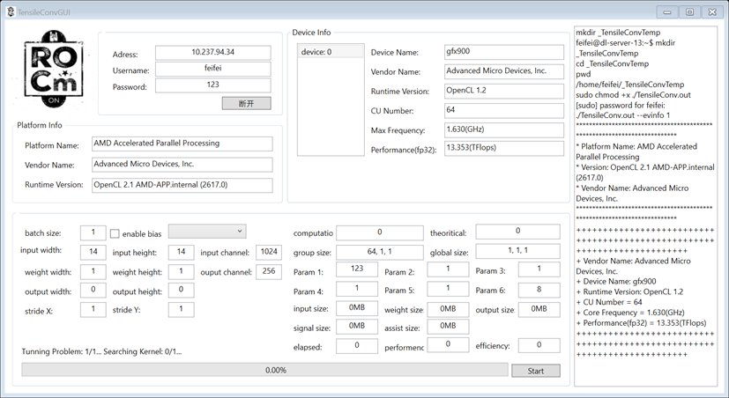
Only for fun – remote GUI

